Slide 1

Stock Market Anomaly Detection and Prediction Using LSTM
This project applies RNN to S&P 500 data, using Long Short-Term Memory networks for two key objectives:
1. Predict stock price movement trends
2. Detect anomalous price behavior patterns

Slide 2



Meet Our Team
Obada
Ali
Ammar
Mahmoud
Data processing and documentation
Paper research, report writing, and presentation lead.
Model training and optimization.
Data collection and performance metrics.
Abdulrahem
Results analysis.

Slide 3
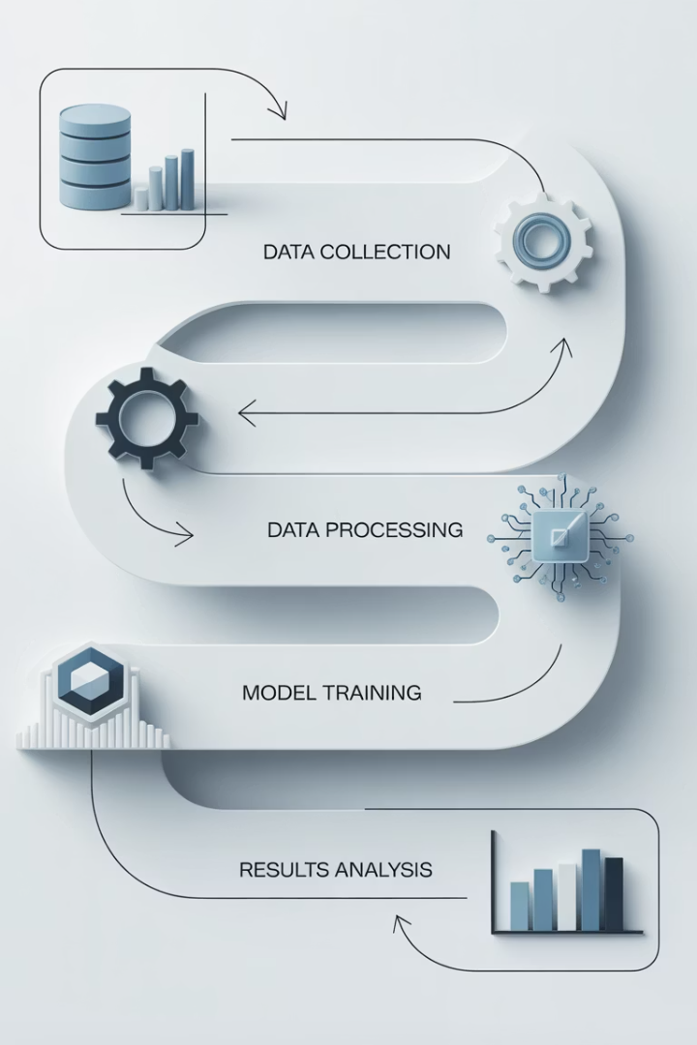




Presentation Overview
Data Collection
Historical S&P 500
Data Processing
Cleaning, normalization, and sequence preparation
LSTM Methodology
Model architecture and training approach
Results
Prediction accuracy and anomaly identification

Slide 4
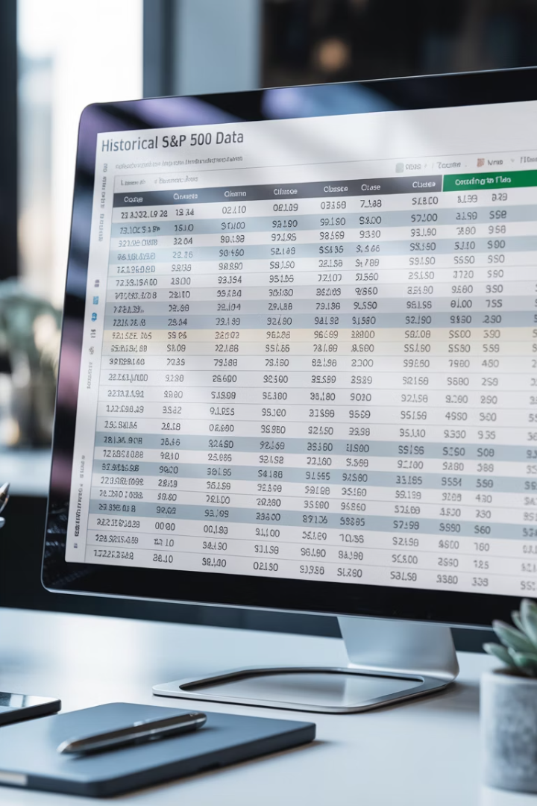




Dataset (S&P 500)
Data Type
The data is numerical and time series in nature spanning daily (1986-2018)
Key Features
Date, and close price.
Primary Target
Close price selected as most representative daily outcome
Data Format
Structured CSV with daily stock market records

Slide 5

Data preprocessing
Train-Test Split
Sequence Generation
80% training data, 20% testing data for model evaluation
Normalization
Creating 60-day input sequences to predict the 61st day price
Date Transformation
MinMaxScaler applied to scale closing prices between 0-1
Converting date strings to datetime objects for proper temporal sequencing
Notes:
In both notebooks, you used this line: pythonCopy code df['Date'] = pd.to_datetime(df['Date']) This converts the "Date" column from plain text (string) into Python datetime objects. This transformation enables: Sorting the data chronologically. Plotting time-based trends. Ensuring correct sequence input for the LSTM model (which depends on the order of time steps). Yes, this improves the temporal sequencing because datetime objects help pandas and other libraries understand the actual timeline.MinMaxScaler transforms each data value to a new scale between 0 and 1 using this formula: iniCopy code X_scaled = (X - X_min) / (X_max - X_min) You used: pythonCopy code from sklearn.preprocessing import MinMaxScaler scaler = MinMaxScaler(feature_range=(0,1)) scaled_data = scaler.fit_transform(data) Scaling to the range [0,1] is common because: It helps neural networks converge faster during training. LSTM models (and most deep learning models) are sensitive to scale — smaller ranges reduce training instability.

Slide 6








LSTM Model Architecture
Dense Output Layer
Final price prediction
Dropout Layers
Preventing overfitting
LSTM Layers
64-unit layers for sequential pattern recognition
Input Layer
60-day price sequences
Model trained with Adam optimizer over 10 epochs using MAE loss function.

Slide 7
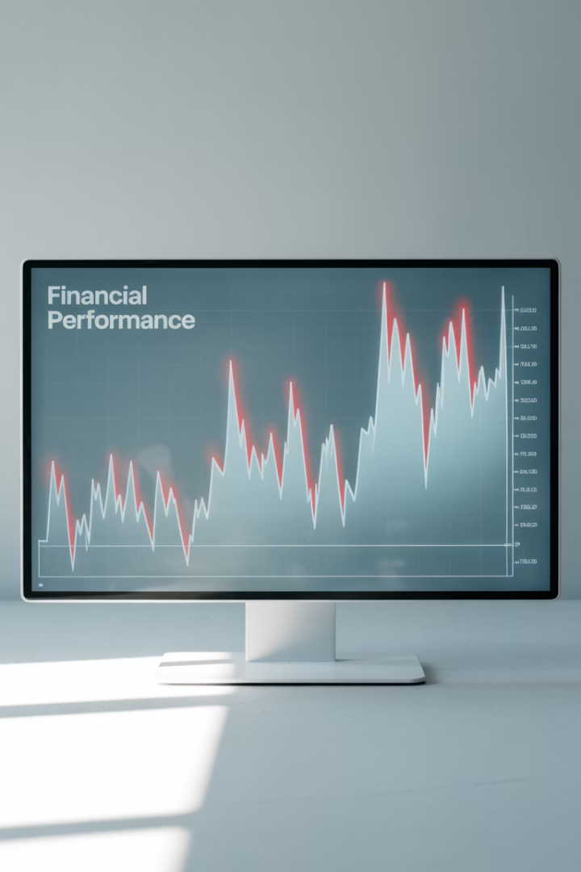
LSTM Autoencoder for Anomaly Detection
Autoencoder Architecture
Used LSTM Autoencoder trained on normal behavior to establish baseline patterns.
Reconstruction Error
Model reconstructs input sequences; high reconstruction error signals potential anomalies.
Threshold Selection
Chose threshold based on error distribution to flag unusual points in financial data.
Real-time Detection
System continuously monitors incoming market data against learned normal patterns.

Slide 8
Price Prediction Performance
Model input: Last 60 days of stock prices
Model output: Next day's price prediction
Time window captures sufficient historical patterns for accurate prediction
Single-step forecasting optimized for short-term market movements
Used many-to-one LSTM architecture
Minimized Mean Squared Error (MSE) during training
Specialized network design for time series sequence processing
Loss function penalizes larger prediction errors more heavily

Slide 9
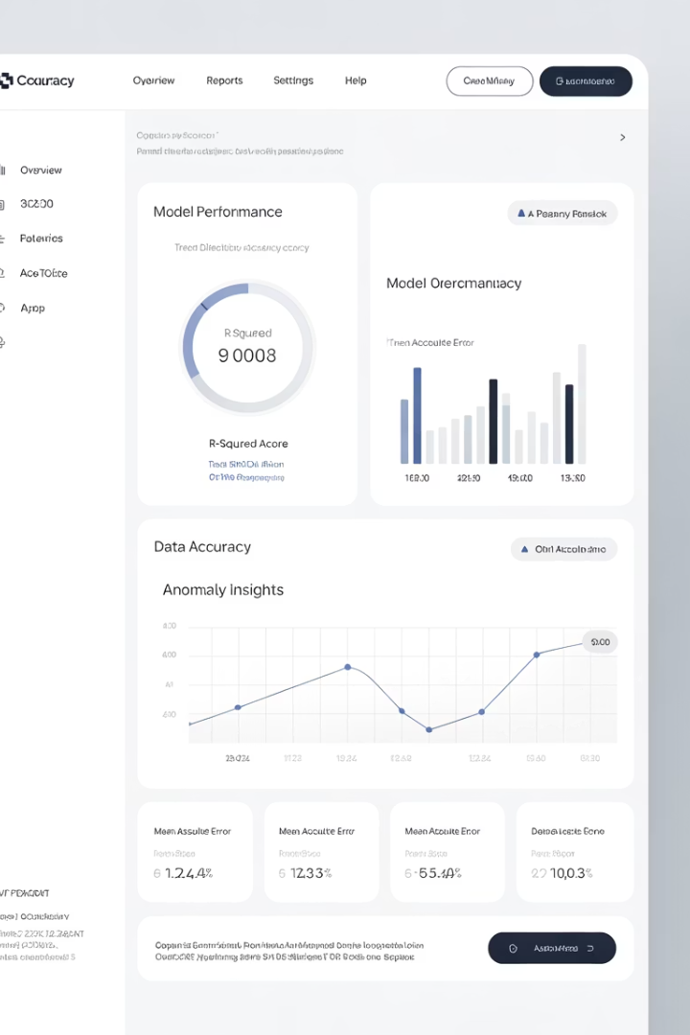
Results & Performance Metrics
95%
Trend Direction Accuracy
Correct prediction of price movement direction
0.01
Loss
loss of prediction
0.02
Root Mean Squared Error
94%
Anomaly Detection Precision
Accuracy of identified anomalies

Slide 10








Conclusions & Future Work
Validated Approach
Potential Enhancements
LSTM models effectively detect anomalies and predict stock trends
Multi-feature modeling incorporating volume and technical indicators
Next Steps
Future Applications
Exploring transformer-based models for improved performance
Real-time prediction systems for trading platforms

